Slide 1
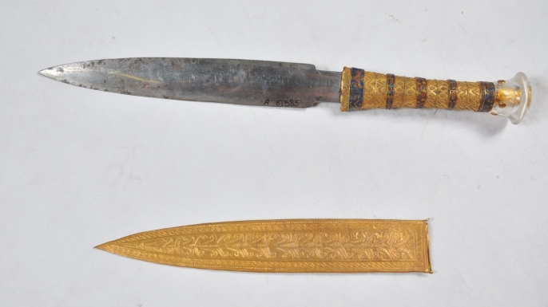
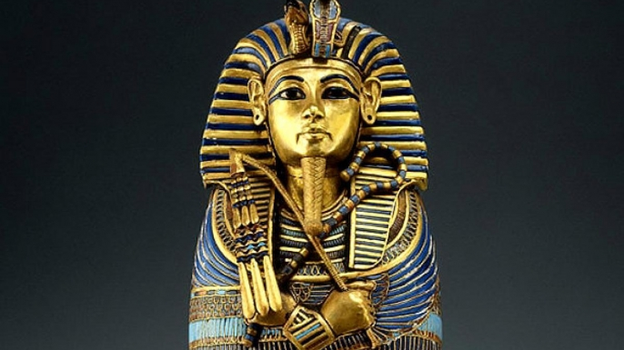
Notes:
A dagger found in the tomb of the Egyptian pharaoh Tutankhamen has been determined to be made from a meteorite.
Tutankhamen ruled during the Bronze age, when iron was rare and very difficult to work. The presence of an iron dagger in Tutankhamen's tomb was itself unusual. The recent tests have determined that the blade likely matches the composition of a meteorite that fell in Marsa Matruh, about 180 mi (290 km) from the capital Thebes.
<number>

Slide 2
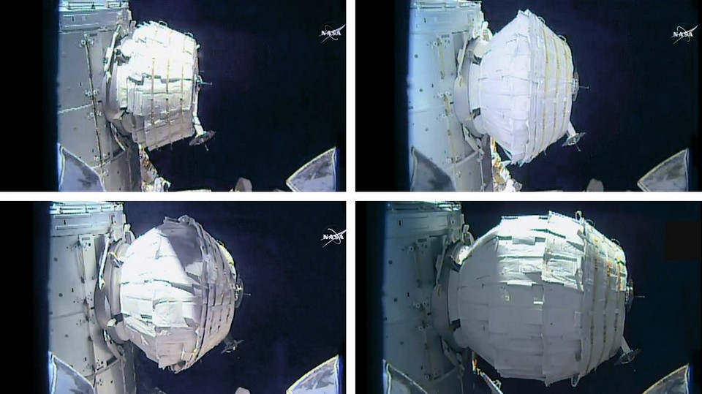
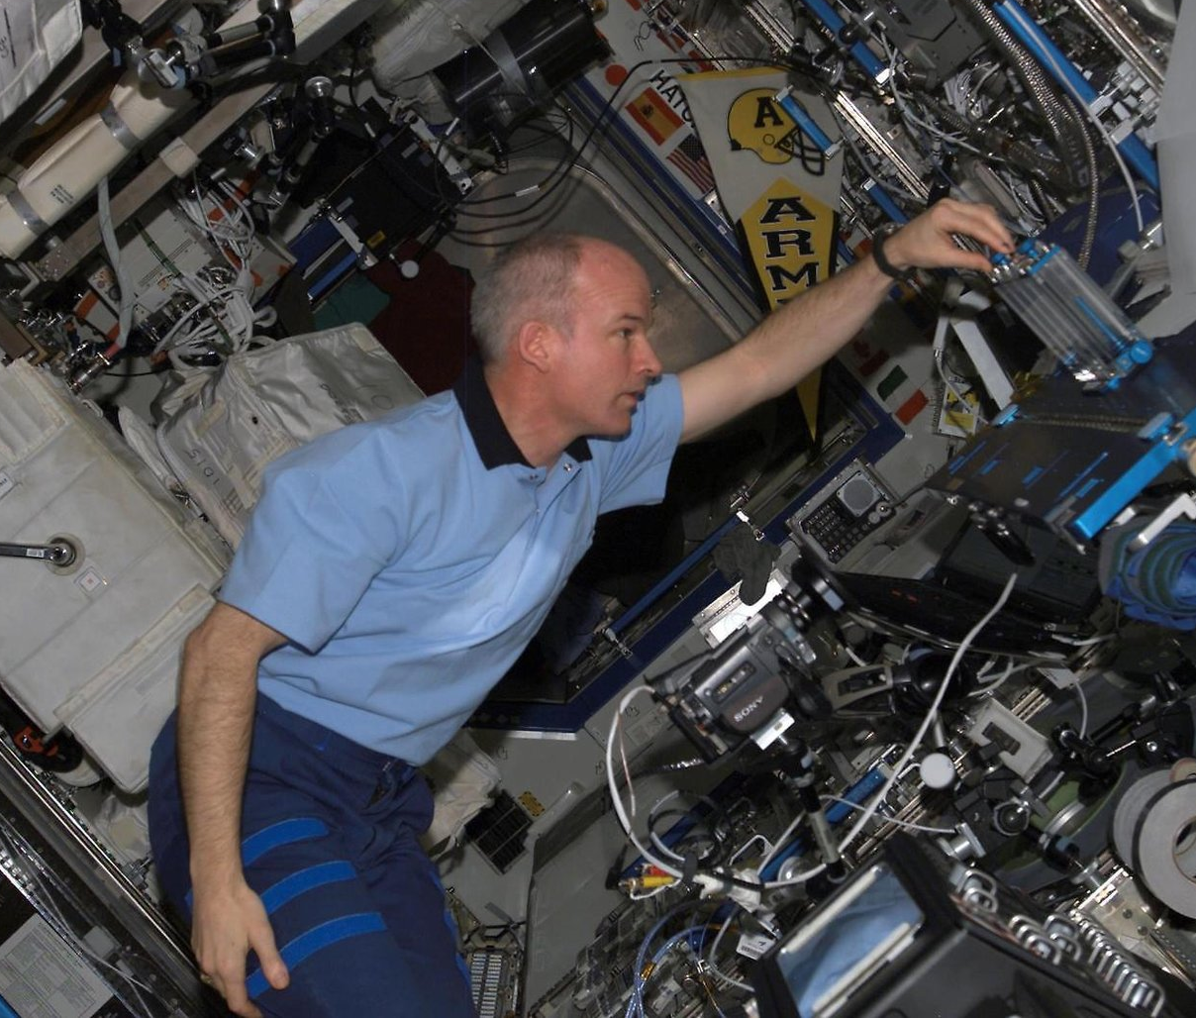
Notes:
The first expandable module for the space station was inflated on May 28. It took astronaut Jeff Williams seven hours to expand the module to its full size of 13 feet long and 10 ½ feet wide. (Williams is expected to make a full recovery after all of the blowing). The module will be used to test technology that may be used as habitats on the Moon.

Slide 3


Notes:
The first evidence of extraterrestrial tsunamis was discovered on Mars. A team led by J. Alexis Rodriguez of the Planetary Science Institute in Tuscon, AZ. The tsunamis were detected by the debris left behind after the tsunami receded
The tsunamis were caused by meteorites crashing into Mars about 3.5 billion years ago, when there were still oceans on the surface. The tsunamis were up to 400 feet high and traveled hundreds of miles inland. By contrast, the Indian Ocean tsunami in 2004 traveled only 1.6 miles inland and was 65 feet high.
<number>

Slide 4
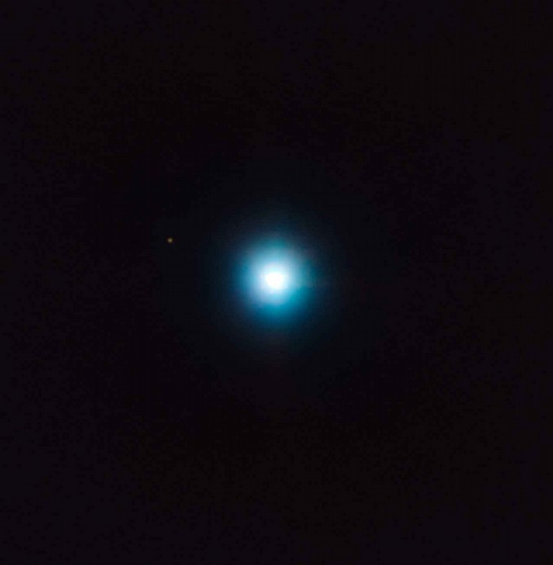
Notes:
A possible planet that is 1200 light years away from our solar system was imaged using the Very Large Telescope in Chile. This planet is 660x further away from it's parent star than Earth is from the Sun. It takes the planet about 27,000 years to orbit its parent star, meaning it still hasn't completed one orbit in the time that it took the light from this planet to get to us. This planet is probably about 5 times the mass of Jupiter, but is much hotter because it is still radiating the heat from its formation.
A different planet was discovered around this same star in 2012 using the transit method (the same method used by the Kepler mission). This is the first time two planets may have been found around the same star using these two different methods of detection.
<number>

Slide 5
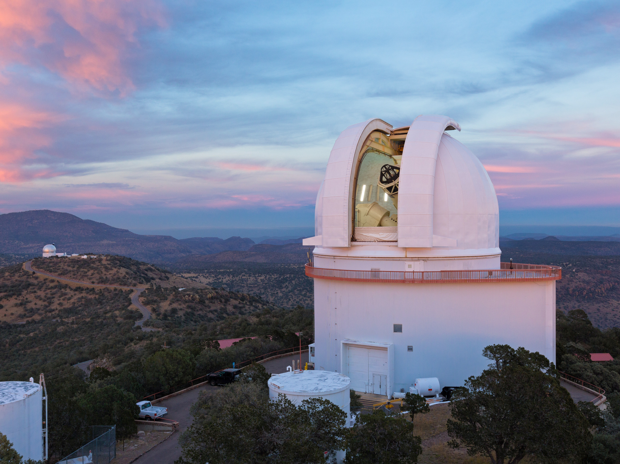


Notes:
A very young but massive planet, clocking in at only 2 million years old and weighing in at 11 times the mass of Jupiter, was found by Rice University astronomer Chrisotpher Johns-Krull.
He was assisted by UT's Jacob McLane, Gregory Mace, and Daniel Jaffe, using the Harlan J. Smith telescope at McDonald Observatory. The discovery was part of a program co-led by Lisa Prato of Lowell Observatory searching for young planets.
Prior to this discovery, it was believed that Jupiter size planets take at least 10 million years to form. Furthomore, since the planet takes only 9 days to orbit its parent star, it probably formed in it
<number>

Slide 6
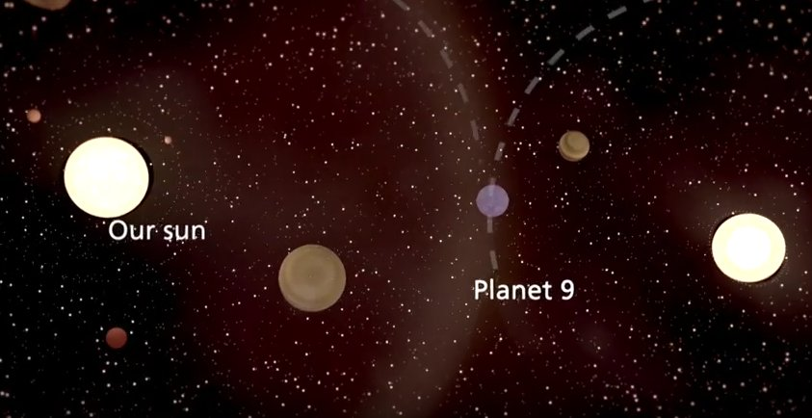

Notes:
Computer models run by Alexander Mustill of Lund University in Sweden suggest that Planet 9 may have been captured from another star.
Planet 9 is a hypothesized planet that could explain the strange alignment of orbits of some distant comets in our solar system. It has not been seen, though there are many astronomers currently searching for it.
The recent paper by Mustill suggests that the planet could have been orbiting another star in the same cluster from which our solar system was born. When the Sun and the other star came a little too close to one another 4.5 billion years ago, the planet was captured by our Sun.
<number>

Slide 7
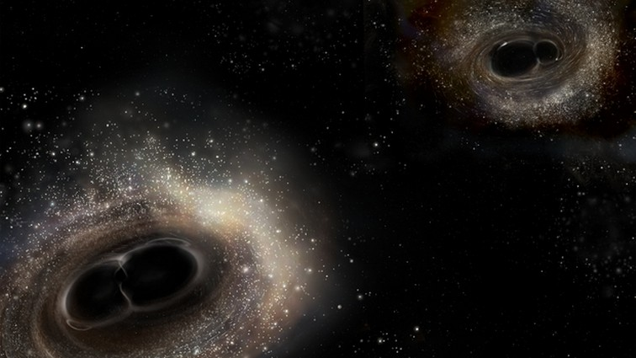
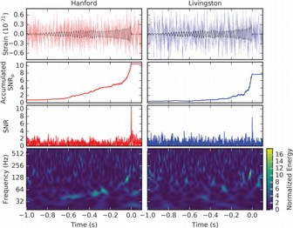
Notes:
The LIGO collaboration reported the second detection of gravitational waves from two merging black holes. These black holes were about half the size or the previously detected pair, weighing in at at total of 21 times the mass of our solar system.
This detection confirms that the first one wasn't a fluke and confirms the existence of black holes of masses more typical of stars.
<number>

Slide 8
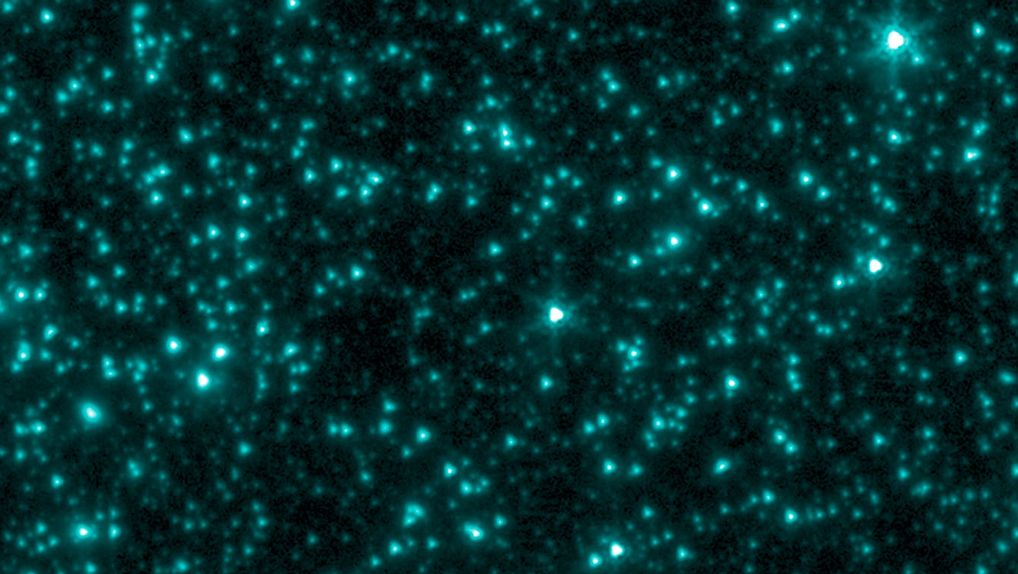
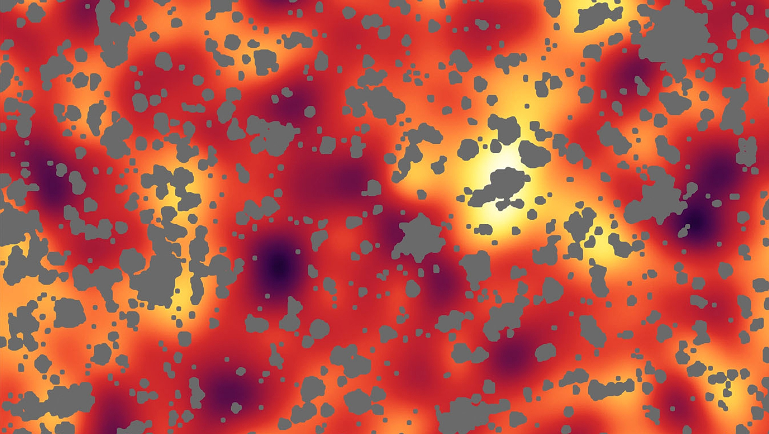
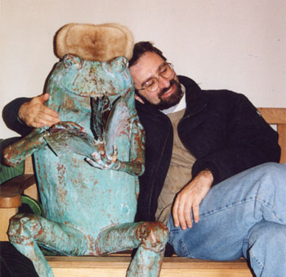
Notes:
Alexander Kashlinsky of the Nasa-Goddard Space Flight Center has proposed that dark matter may consist of black holes formed early in the universe, within the first 300 million years after the Big Bang.
Black holes with a mass of about 30 times that of our Sun would naturally explain clumpiness that is seen in the background glow of the universe. This mass is also similar to that of the black holes detected by LIGO last September, which may explain why such massive black holes exist in the first place.
<number>

Slide 9
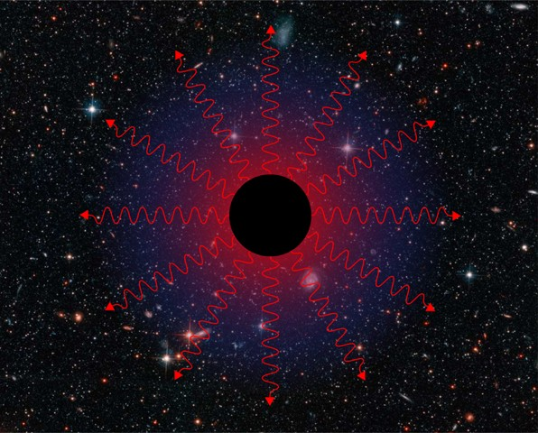

Notes:
Stephen Hawking, in collaboration with Malcolm Perry of Cambridge and Andrew Strominger of Harvard, recently published a paper suggesting that black holes have “soft hair”, that is, they information about the material that has been trapped in the black hole is stored in a thin layer just outside the black hole. This is in contrast to ideas about black holes developed in the 1970s which required black holes to have “no hair”, and are defined only by their mass, spin, and electric charge.
“Bearded” black holes, as proposed by Austin hipsters, haven't yet yet been accepted in the field.
<number>

